Slide 1
Fasion Sale Dynamic Dashboard
By Gummadi Sai Dheeraj

Slide 2
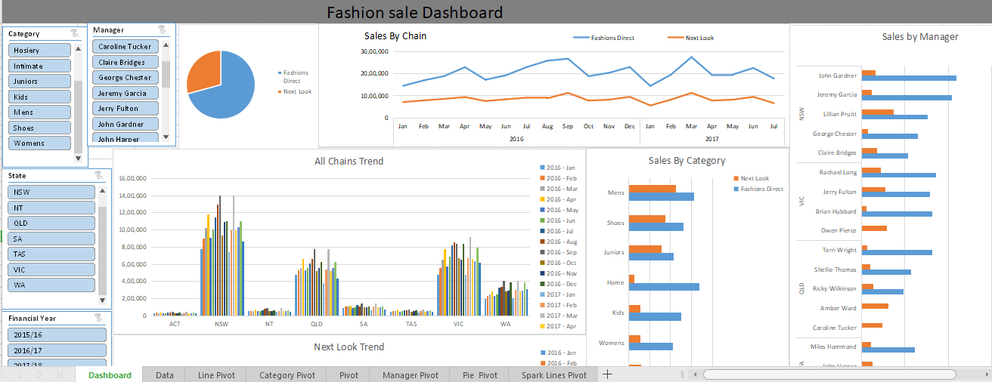
Introduction
Dashboard is display of most important information

Slide 3
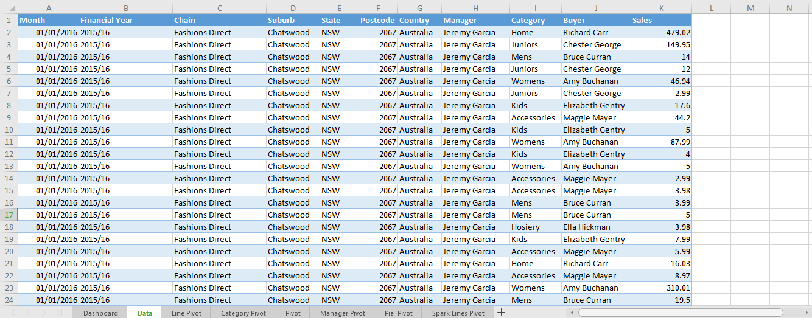
Data Set
I took my dataset from data world website (“https://data.world/datasets/fashion”)
My data has 72,426 rows and 11 columns

Slide 4
References:
https://www.youtube.com/watch?v=rBuiBNZWjE4
https://www.youtube.com/watch?v=RM8T1eYBjQY
https://youtu.be/MEwigYNZwXw
https://youtu.be/qPJMrwtYSDc
https://youtu.be/RM8T1eYBjQY
https://youtu.be/9p6tWCHbtPQ
trumpexcel
samrtsheet
Analytics Vidhya

